Slide 1

WINTER SCHOOL ON COGNITIVE MODELING (WSCM) - 2020
15/12/2020 – 17/12/2020
Indian Institute of Technology Mandi, India

Slide 2
Objectives of the Winter School
To provide you a forum to train you on the best practices in the area of cognitive modeling
Expose you to the state of the art models in basic and applied domains
Involve top international researchers in the area of cognitive modeling to present their work as part of the winter school

Slide 3
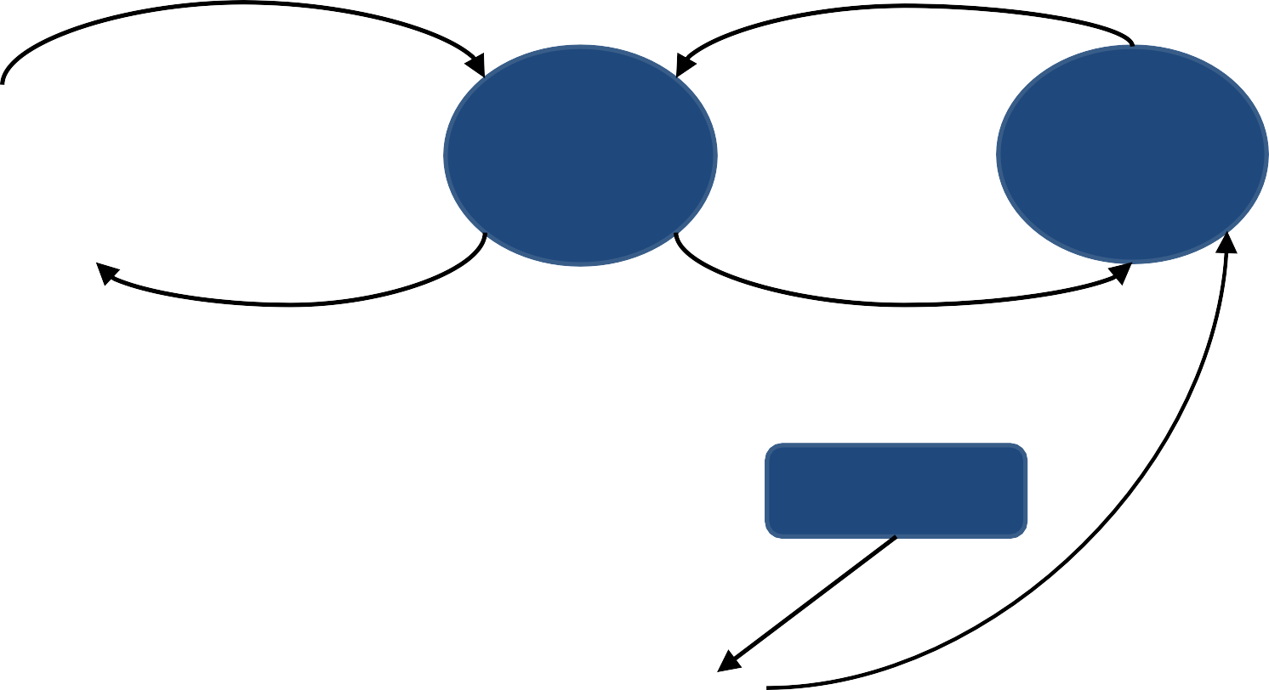

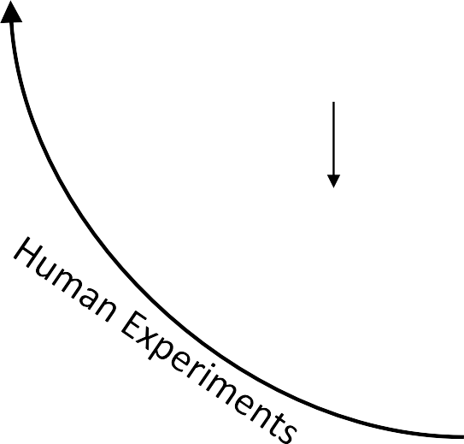

Cognitive Modeling
Experimentation
Decisions
Computational Modeling
Decisions
-ACT-R
-Nengo
-PyIBL
-Diffusion Models
Decision Task
Cognitive
Model
Participant
Feedback
Feedback
Human Data
Model Data
Comparison

Slide 4
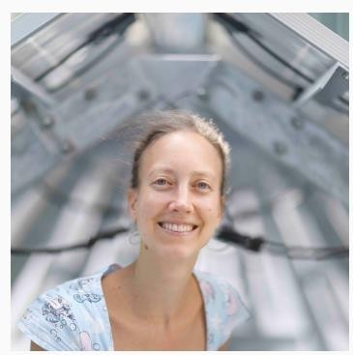
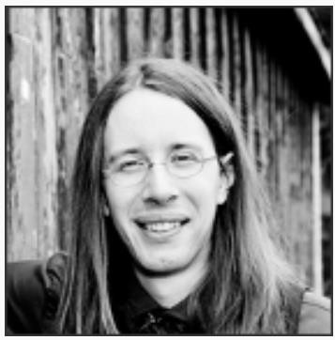
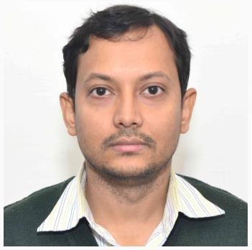
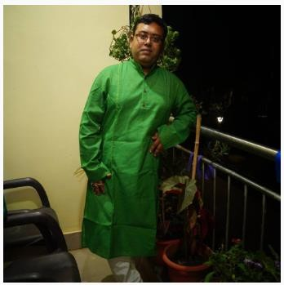
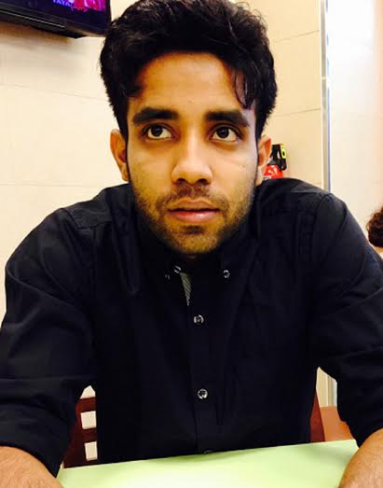
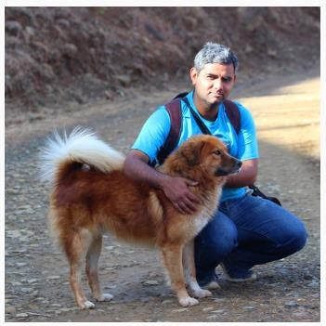
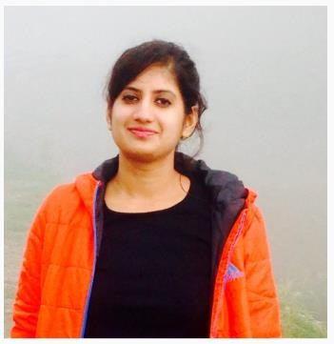
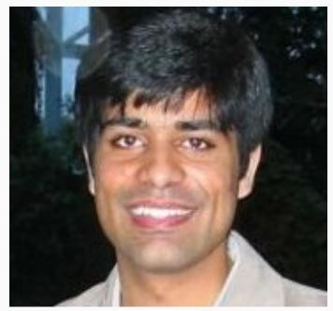
Speakers

Slide 5
WSCM 2020 @ https://meet.google.com/ywt-rxmj-dtk

Slide 6
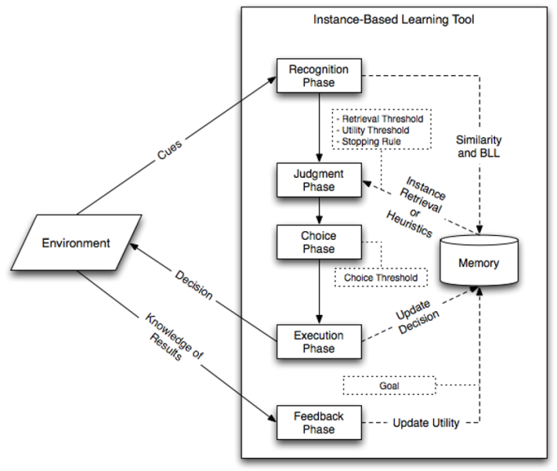






How do we make decisions? Instance-based Learning Theory (Dutt & Gonzalez, 2012; Dutt & Kaur, 2013; Gonzalez & Dutt, 2011; 2012, Sharma & Dutt, 2017)
A Simulated Decision Maker
A Decision Task
Exchange of Information

Slide 7
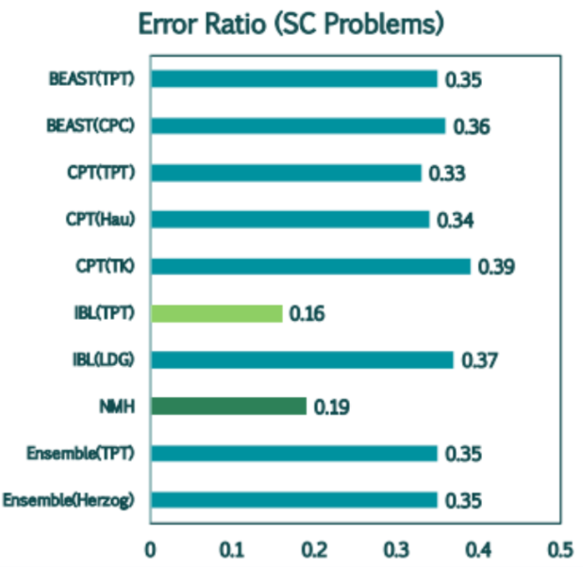
Decision-making in Bandit Problems (in collaboration with University of Groningen, Netherlands)
Contribution: To explain people’s choices in experience via aggregate and hierarchical models at the individual level
Experience
Sampling phase
3
(Sharma & Dutt, 2017)
Description
0
32, 0.1
0, 0.9
3, 1.0
0
Your choice
Decision phase
48%
DE Gap
20%
(Sharma, Debnath, & Dutt, 2018)
Aggregate Models
Instance-based learning (IBL) model, Natural mean heuristic (NMH) model, Cumulative prospect theory (CPT)
Hierarchical Models
Best Estimate and Simulation Technique (BEAST) model Ensemble model
20% 80%
d=5.39, 𝝈=0.04
Explain individual decisions
7
Notes:
Make the boxes bigger – we need to test the boxes with projector in the lab as well as in A4 conference room.
We need to insert d and s parameters.

